Slide 1
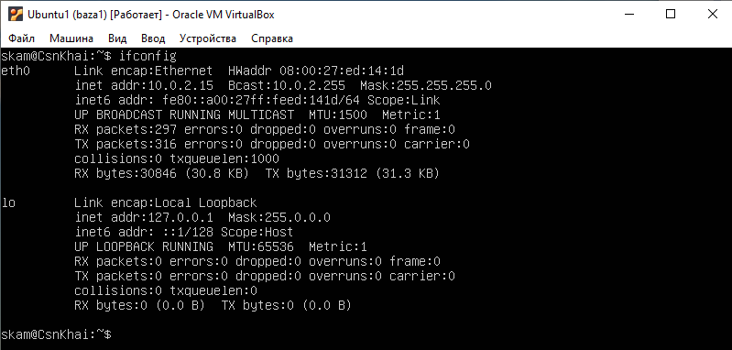
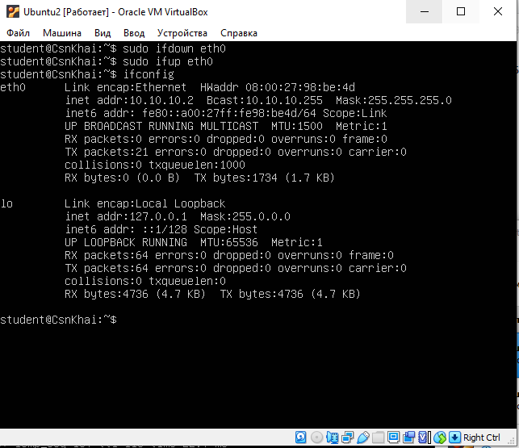
First checking ifconfig on both machines
That’s data before making any
settings

Slide 2
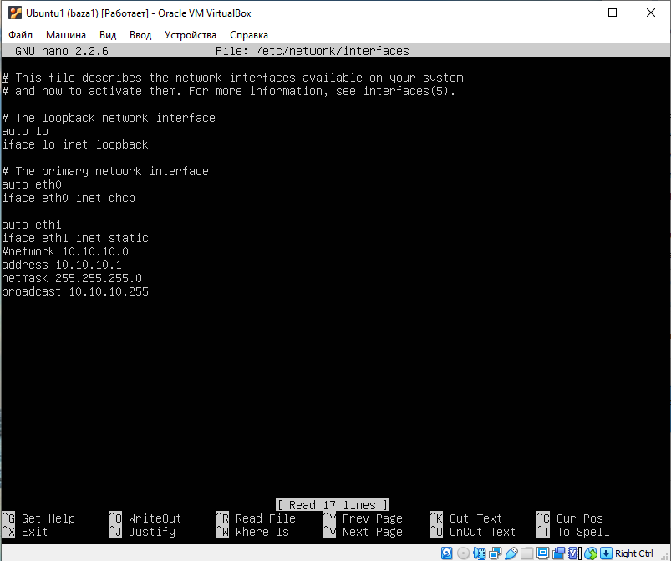
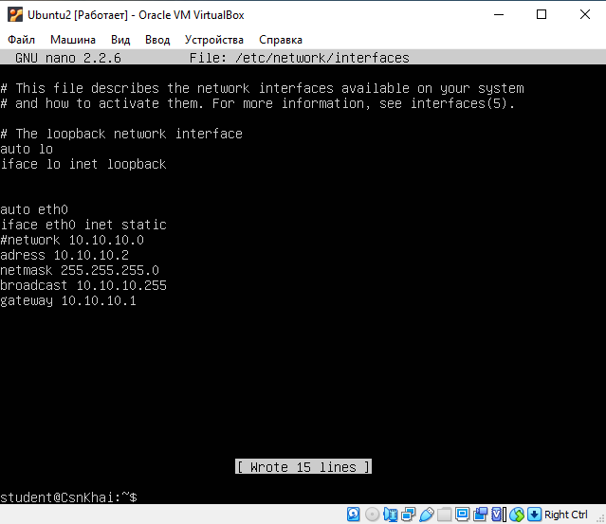
sudo nano /etc/network/interfaces
Settings for interfaces on VM1 and VM2

Slide 3
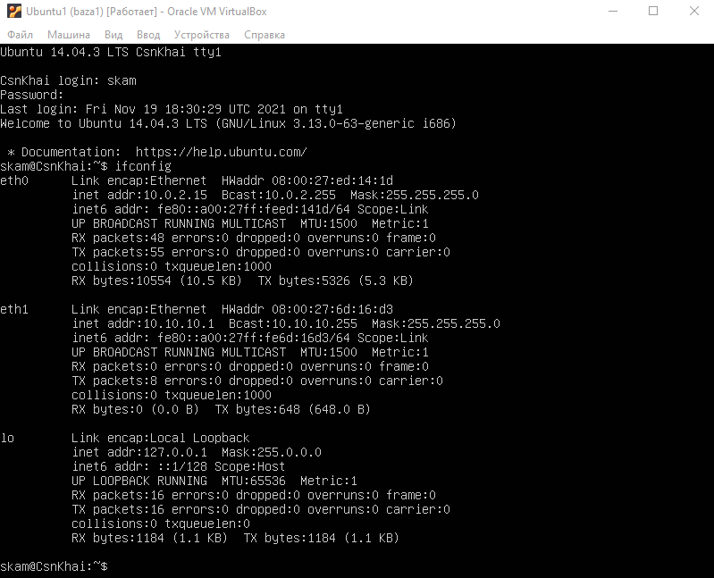
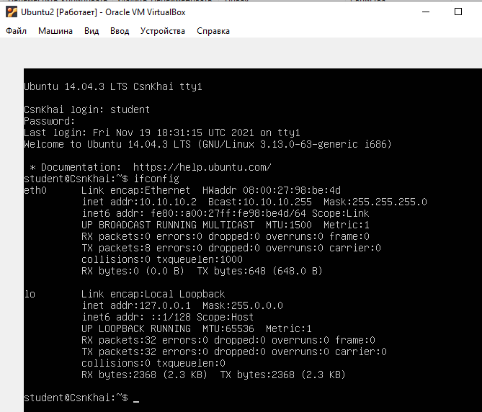
Ifconfig again to check

Slide 4
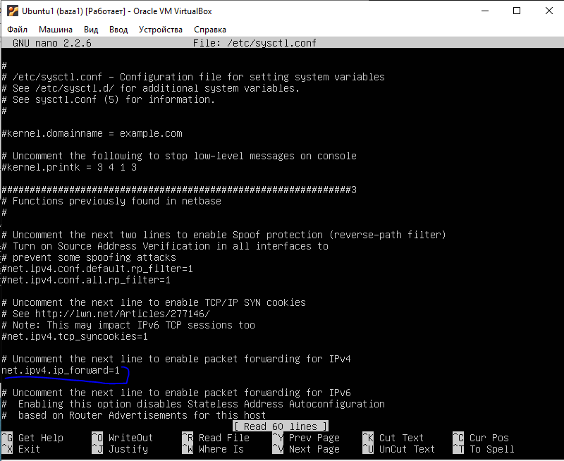
Uncommenting this line (nano sudo /etc/sysctl.conf)

Slide 5
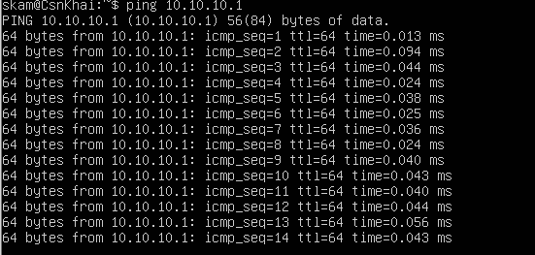
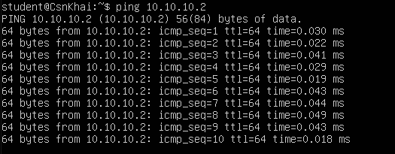
Using command for VM1
Rebooting and checking ping
VM1 VM 2

Slide 6
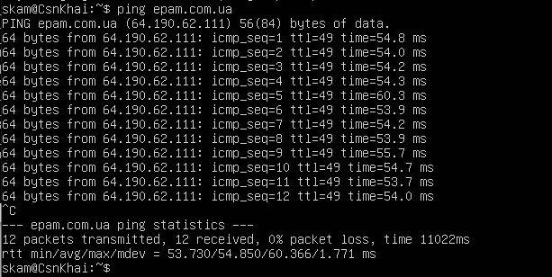
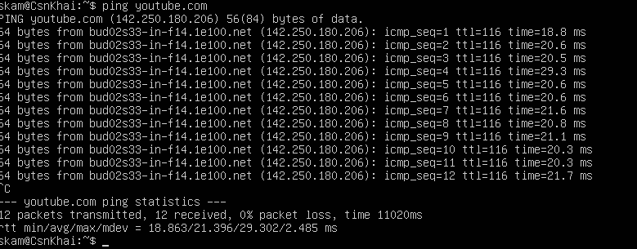
Checking epam ping
Checking YouTube ping

Slide 7
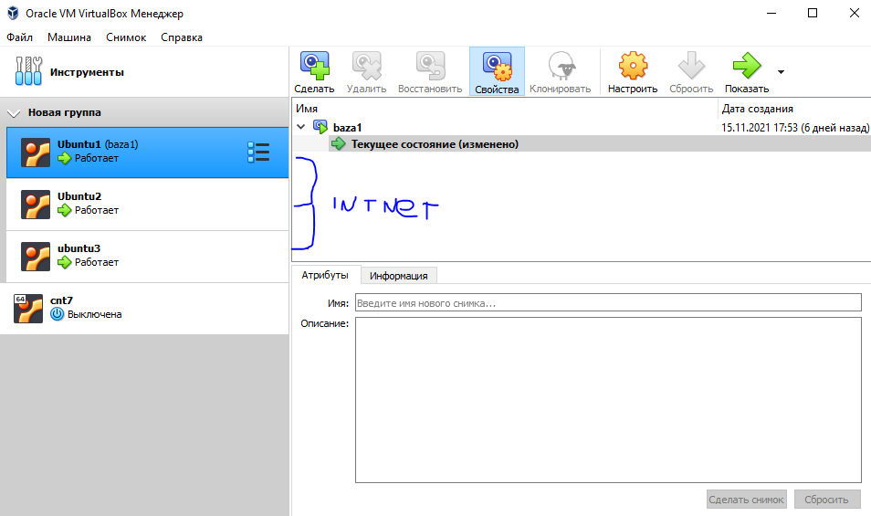
Adding 3rd machine (same way as VM2 only 1 adapter)

